Slide 1
Computer Languages
To write a program for a computer, we must use a computer language. Over the years computer languages have evolved from machine language to natural languages.
Topics discussed in this section:
Machine Languages
Symbolic Languages
High-Level Languages

Slide 2
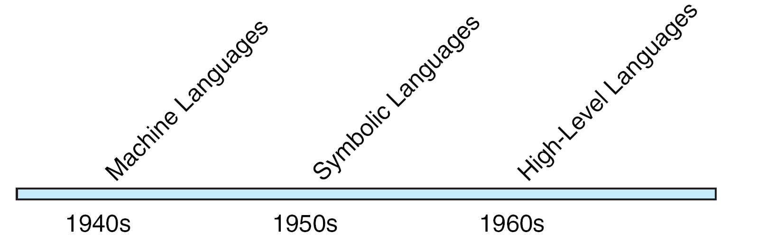
FIGURE 1-9 Computer Language Evolution

Slide 3
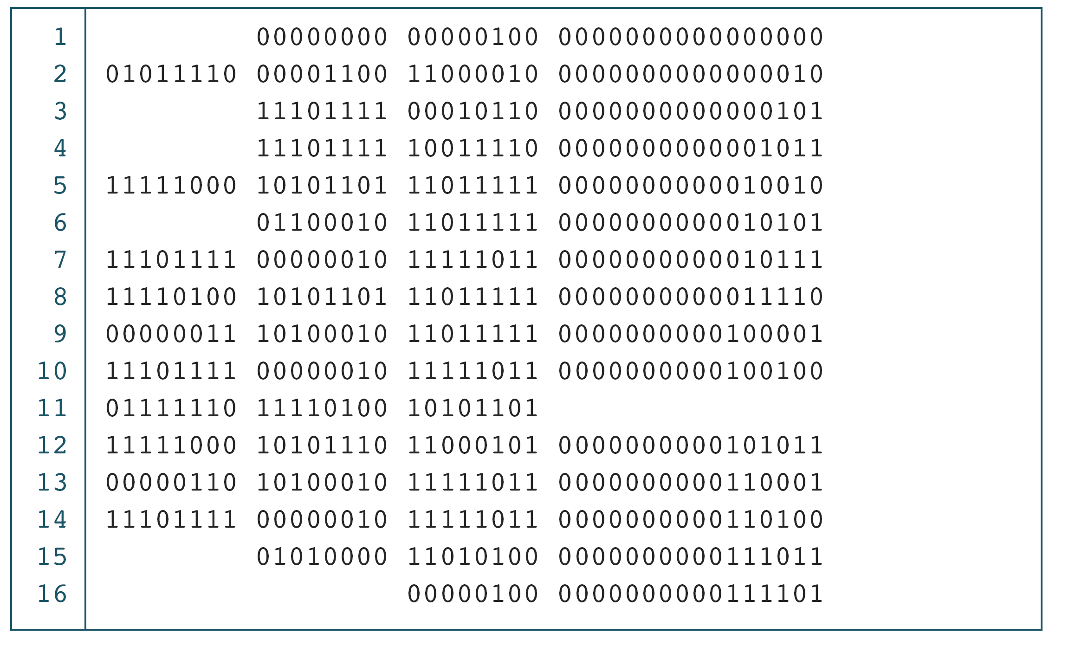
PROGRAM 1-1
The Multiplication Program in Machine Language

Slide 4
Note
The only language understood by computer
hardware is machine language.

Slide 5
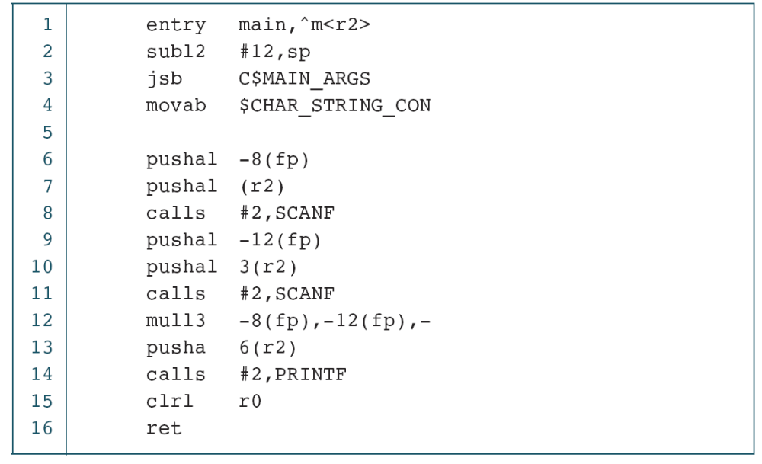
PROGRAM 1-2
The Multiplication Program in Symbolic Language

Slide 6
Note
Symbolic language uses symbols, or mnemonics, to represent the various machine language instructions.

Slide 7
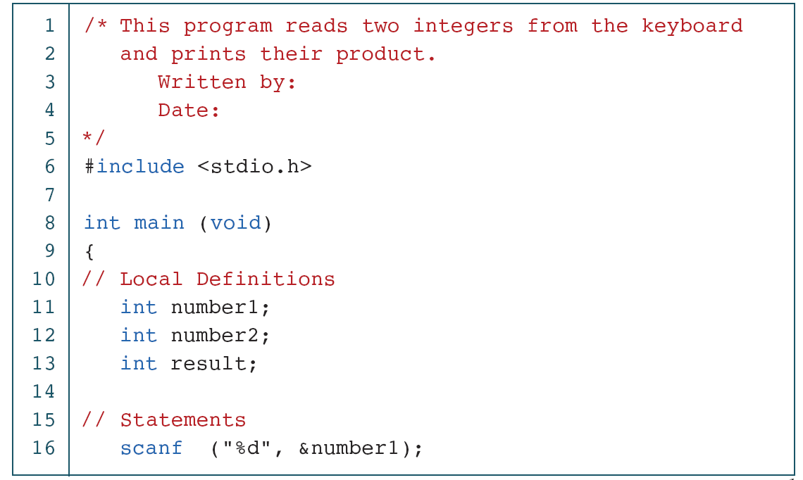
PROGRAM 1-3
The Multiplication Program in C
continued

Slide 8
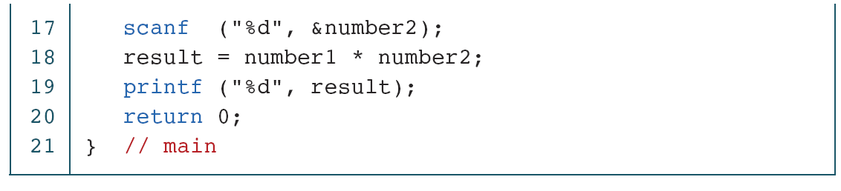
PROGRAM 1-3
The Multiplication Program in C (continued)

Slide 9
1.4 Creating and Running Programs
In this section, we explain the procedure for turning a program written in C into machine language. The process is presented in a straightforward, linear fashion, but you should recognize that these steps are repeated many times during development to correct errors and make improvements to the code.
Topics discussed in this section:
Writing and Editing Programs
Compiling Programs
Linking Programs
Executing Programs

Slide 10
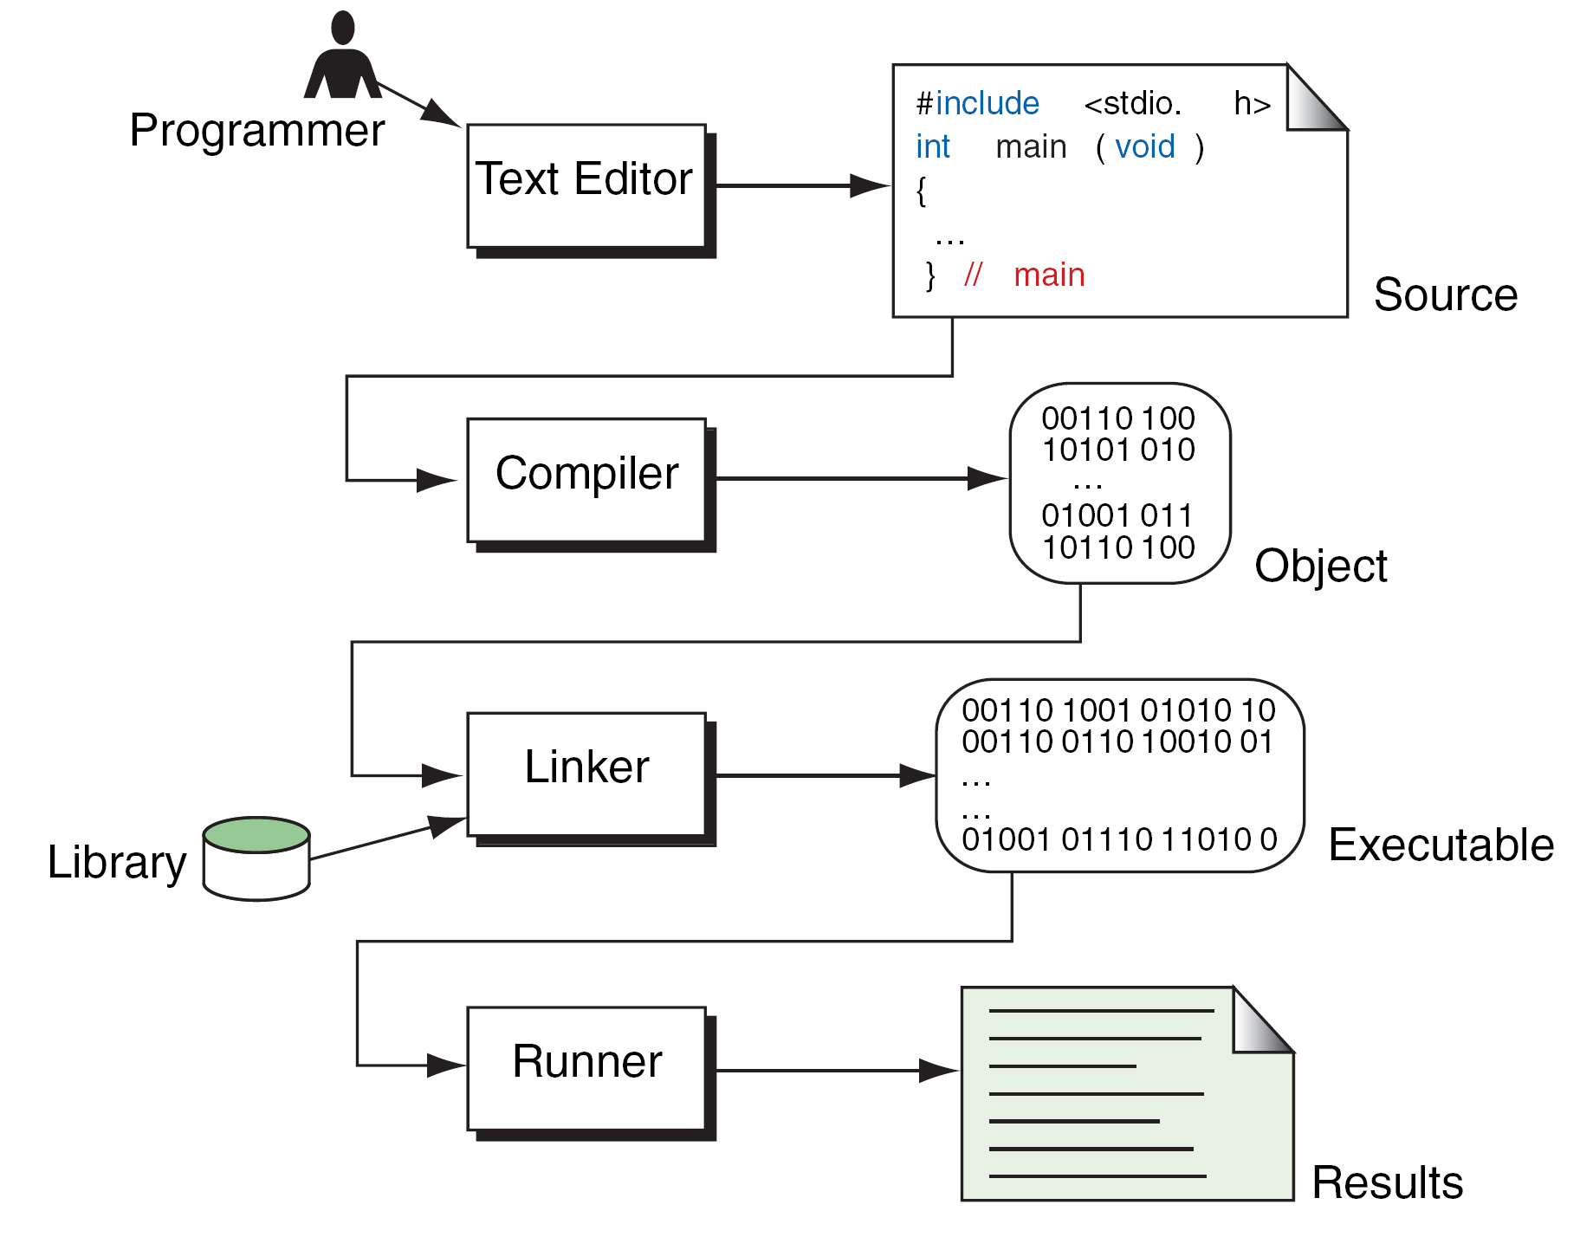
FIGURE 1-10 Building a C Program

